Slide 1

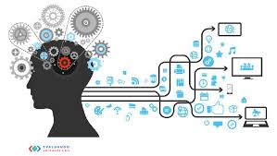


Health Insurance-Premium-Prediction Using IBM Auto AI Service
TEAM - 02 Ch.Sanjana D.Ashish C.Tharun D.Sravani G.Harika

Slide 2

INTROCDUCTION TO AI IN HEALTH CARE
AI increases the ability for healthcare professionals to better understand the day to day patterns and needs of the people they care for better feedback guidance and support.
AI is already being used to detect diseases such as cancers at a very early stage.
Technology applications and apps encourage healthier behavior in individuals and help with proactive management of healthy lifestyle.

Slide 3
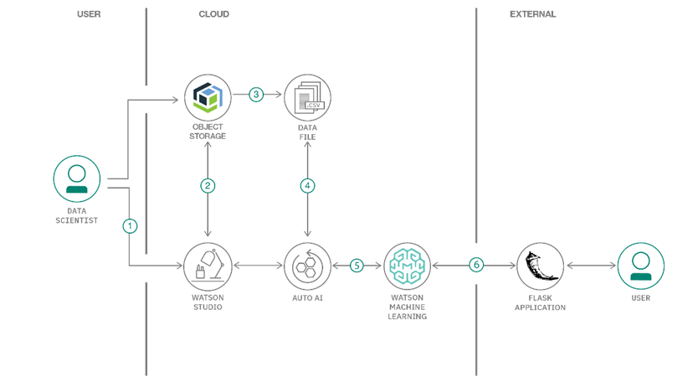
DATA SET
1.The user creates an IBM Watson Studio Service on IBM Cloud.
2.The user creates an IBM Cloud Object Storage Service and adds that to Watson Studio.
3.The user uploads the insurance premium data file into Watson Studio.
4.The user creates an AutoAI Experiment to predict an insurance premium on Watson Studio.
5.AutoAI uses Watson Machine Learning to create several models, and the user deploys the best performing model.
6.The user uses the Flask web application to connect to the deployed model and predict an insurance charge.

Slide 4

APPLICATIONS:
It Is used to predict whether the person is eligible to get the insurance or not.
It is used to predict the charges for the health insurance.
Medical diagnostics.
Diseases prediction and smart health records
Image and facial recognition.
Satellite imagery fusion and analysis.
Real-time language translation.

Slide 5


PROBLEM STATEMENT:
Health Insurance-Premium-Prediction Using IBM Auto AI Service

Slide 6
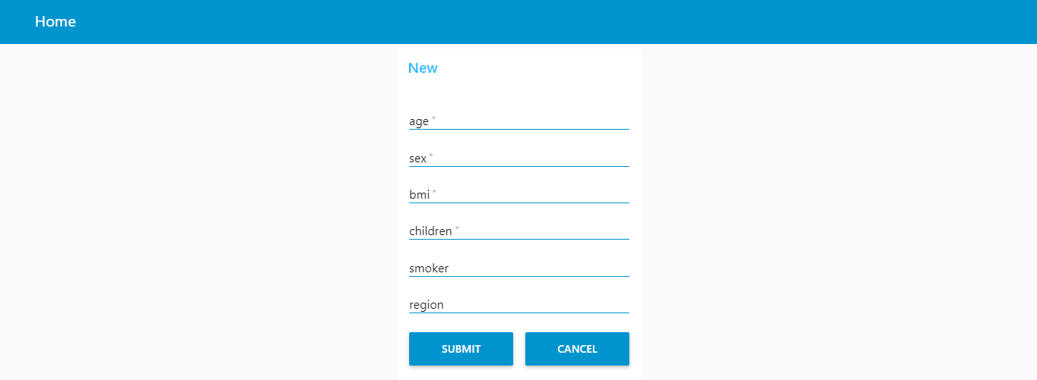
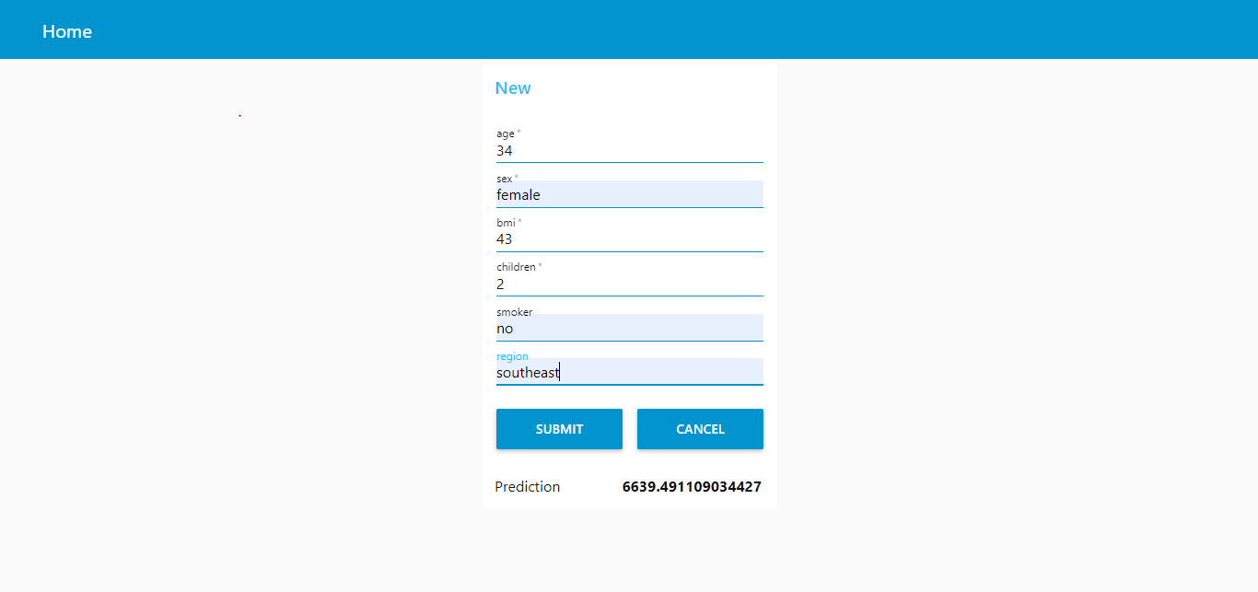
OUTPUT DEMO:
1:
2: 3: PREDICTION

Slide 7

CONCLUSION
1. AI saves time by which we can quickly set up the services on IBM Cloud to build the model
2.The data is used and initiates the AutoAI process
3.Build different models using AutoAI and evaluate the performance
4.Choose the best model and complete the deployment
5.Generate predictions using the deployed model by making REST calls
6.Compare the process of using AutoAI and building the model manually
7.Visualize the deployed model using a front-end application

Slide 8
THANK-YOU!

